Slide 1

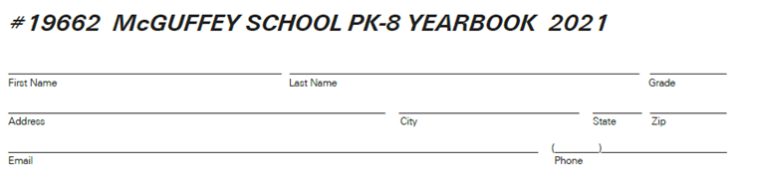
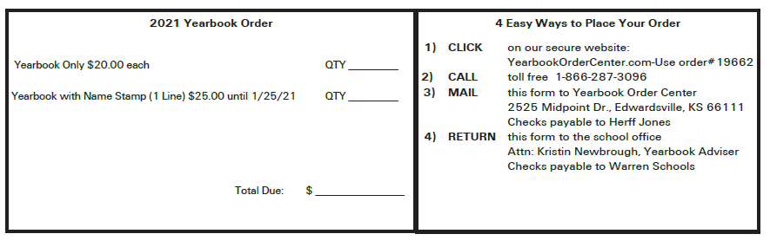
2022
Payment Due by March 1
Homeroom teacher: _________________

